Slide 1

NETFLIX DASBOARD

Slide 2
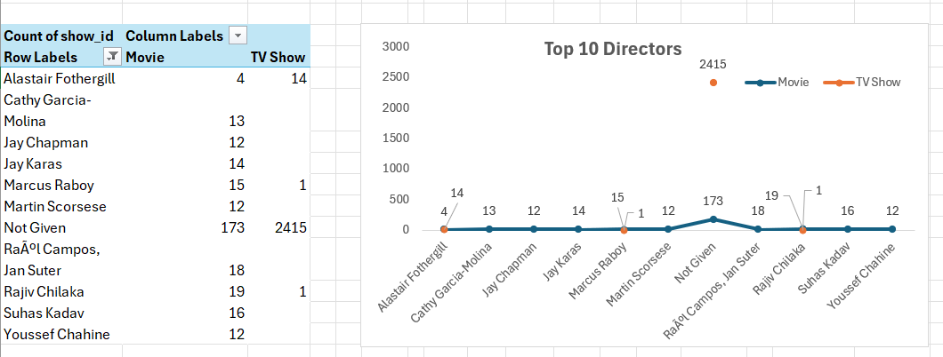
Top 10 Directors

Slide 3
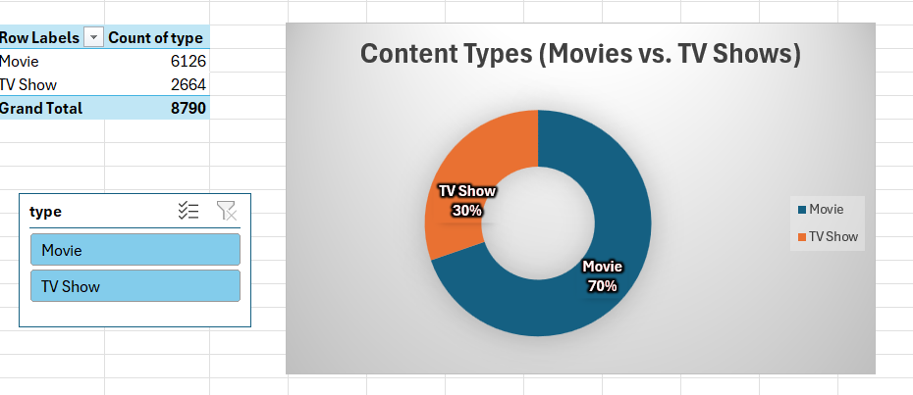
Content Types

Slide 4
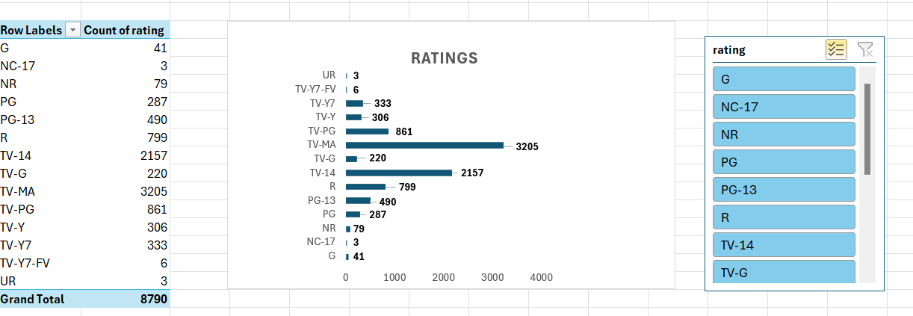
Ratings

Slide 5
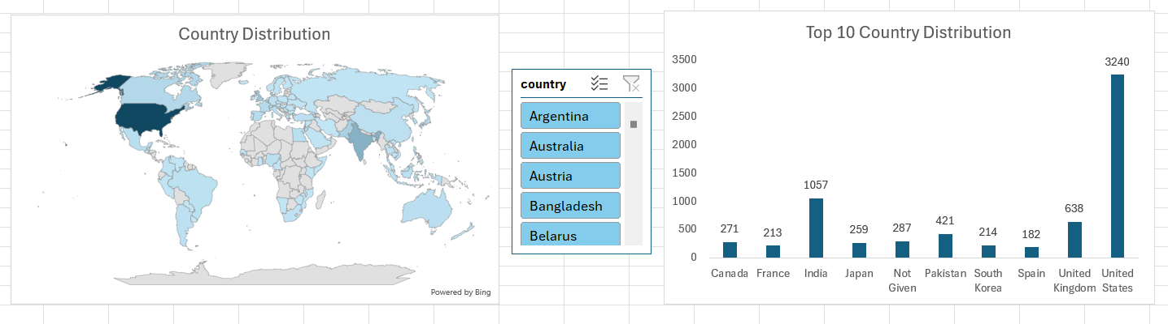
Country Distribution

Slide 6
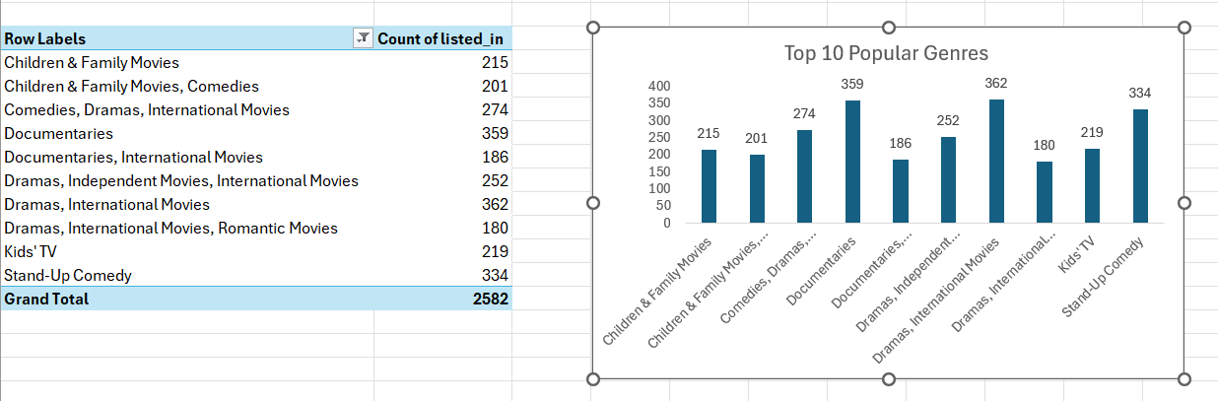
Popular Genres

Slide 7
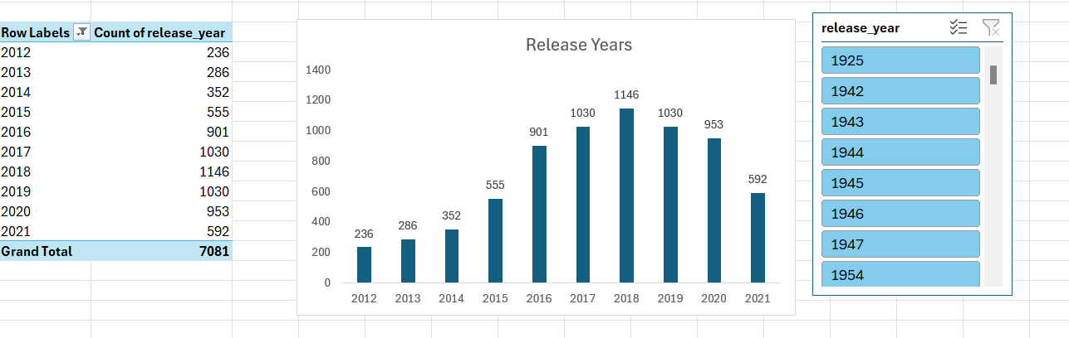
Release Years

Slide 8
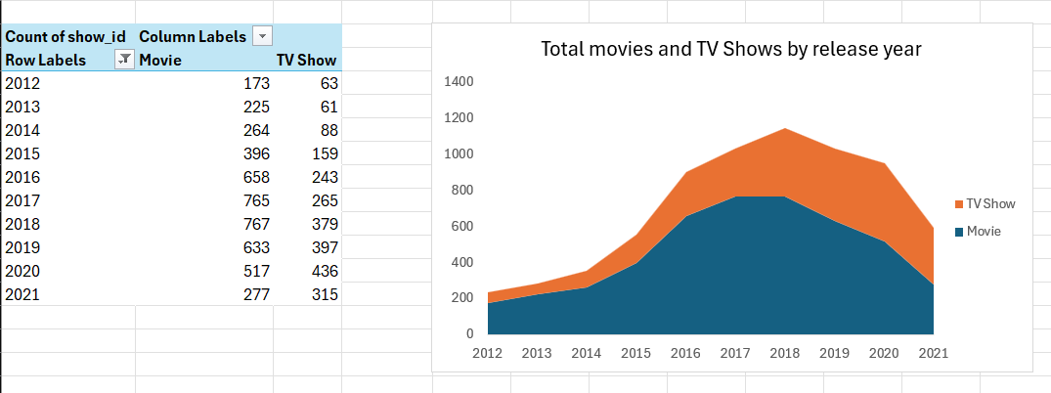
Total Shows And Movies By Year

Slide 9
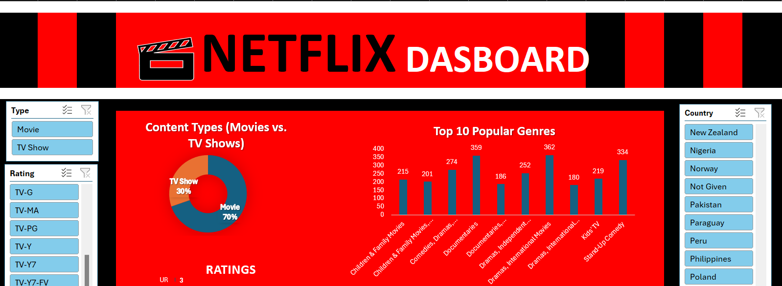
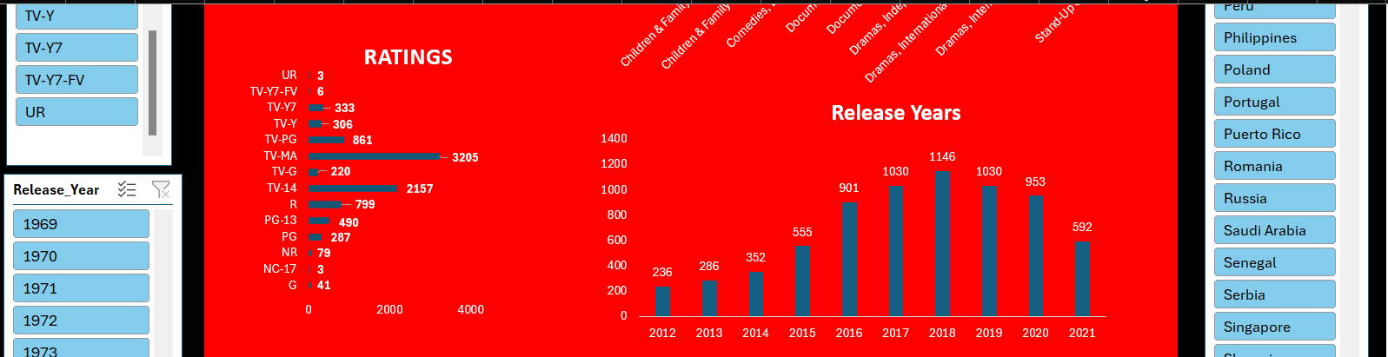
Netflix Dashboard

Slide 10
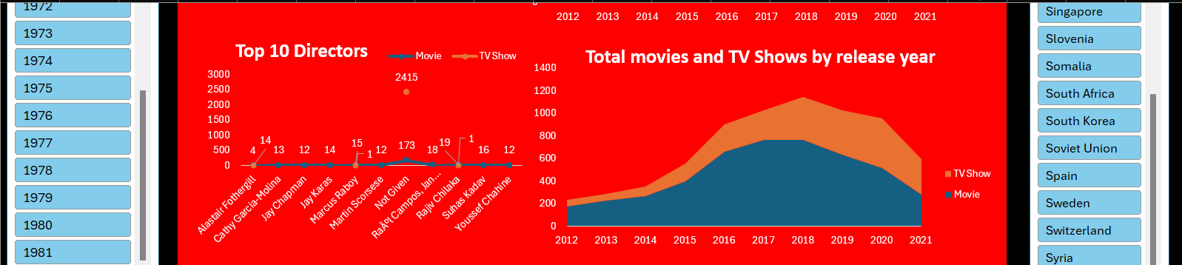
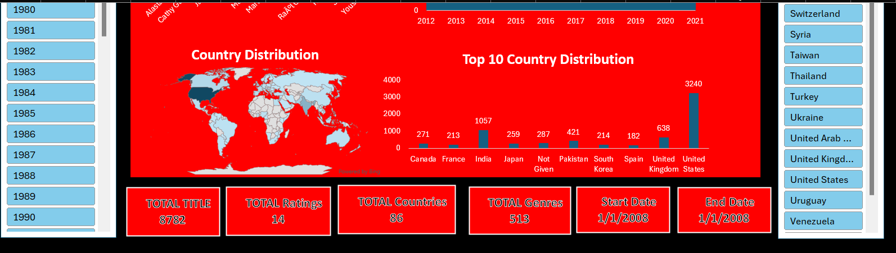

Slide 11
Insights
1. Content Mix :- Movies account for 69.7% of Netflix's library, while TV Shows make up 30.3%.
2. Rating Breakdown :- R-rated movies (34.6%) and TV-MA shows (55.6%) are the most prevalent.
3. Growth Trend :- Netflix's content additions -
Peaked in 2018
Declined by 21.5% by 2021
4. Top Directors
Notable directors on Netflix:- Marcus Raboy, Jay Karas, Martin Scorsese
5. Original Content :- Netflix's original content-
Grew steadily from 2012 to 2018
Declined by 43% from 2018 to 2021

Slide 12
Recommendations
1. Analyze movie genres, TV show engagement, and content additions/removals.
2. Evaluate viewer engagement by genre, rating, and director.
3. Assess demand for underrepresented genres and diverse ratings.
4. Consider international partnerships based on genre preferences.
5. Collaborate with popular directors to boost subscriber growth and engagement.

Slide 13
THANK YOU

